Slide 1


Permanent Committee on Cadastre in the European Union
      Romanian Cadastre –
      a trustworthy institution for the society
      PCC Conference
      20 – 21.11.2018
      Vienna
ELRN
Bucharest
Romania
19th of June 2012

Slide 2
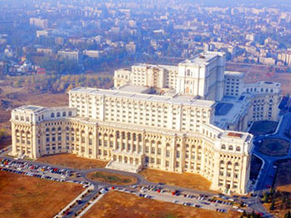
National Agency for Cadastre and Land Registration - Romania
ELRN
Bucharest
Romania
19th of June 2012
Cadastre, Land Book and Cartography under a sole state authority: ANCPI

Slide 3
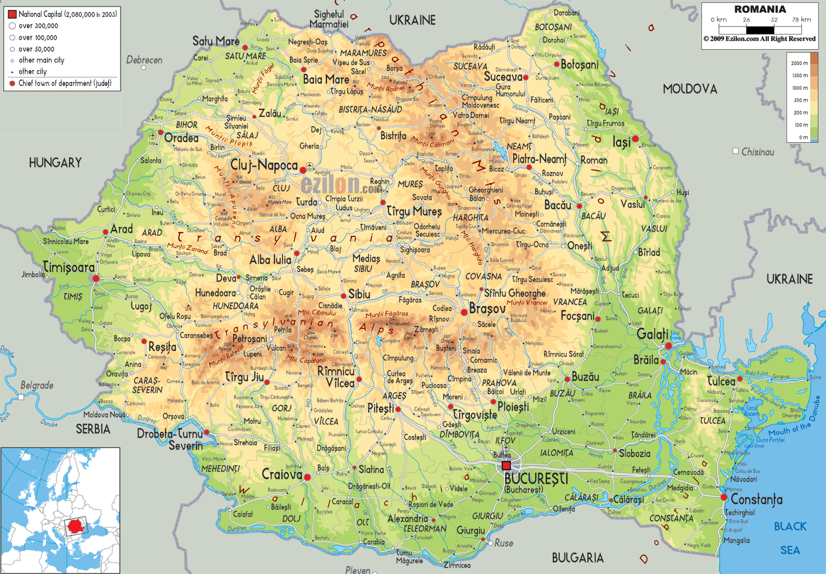
Romania
area – population - organization
Population:
19,5 M (as of 2018)
Area:
238 397 km²
3181 administrative territorial units (UATs)
2861 rural
320 urban
ELRN
Bucharest
Romania
19th of June 2012

Slide 4
Agenda
1
2
3
4
5
Historical Context
Institutional Organization
Land registration systems
Registration process in Romania
National Program for Cadastre and Land Book
ELRN
Bucharest
Romania
19th of June 2012

Slide 5
Historical Background
1870
1918
1921
1933
1938
Establishment of Romania
First land reform (Law of 30 July)
First cadastral law (Law no.93)
First land registration law (Decree-Law no. 115/1938)
Land book system introduced in Transylvania and North Bucovina
1945
Second land reform
1948
Nationalization of properties, collectivization of land
1960 - 1995
Land Registry managed by State Notaries
1989
New political regime starts in Romania
1991
Third land reform for restitution laws (Law no 18)
1995
Land Registry transferred to local courts
1996
New Law on cadastre and land registration (Law no.7/1996)
2004
Cadastre and land book in a single Agency:
ELRN
Bucharest
Romania
19th of June 2012
National Agency for Cadastre and Land Registration

Slide 6
National Agency for Cadastre and Land Registration
ANCPI
Territorial Offices (135)
Offices for cadastre
and land registration (42)
Public relations offices (41)
National Centre for Cartography
Over 3000 employees + 600 for NCLBP
ELRN
Bucharest
Romania
19th of June 2012

Slide 7
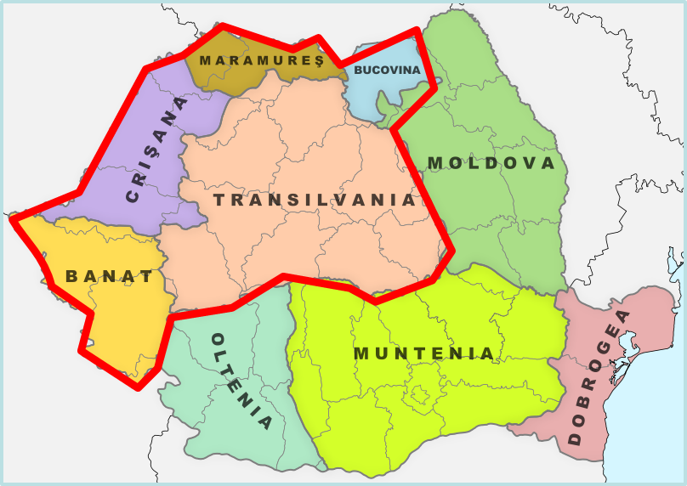
Inherited Land registration systems
Registration system based on Land Books
Areas where applied
System features
Registration effect
Trust in the system
Transylvania, North Bucovina
One owner, one Land Book, all the properties recorded in the same Land Book: system based on owner
Identifier of parcels: topographic number
Constitutive of rights
“Who has Land Book, has a true Ownership”
Information registered:
textual information on property and rights
no plan of property, “plan of village”
ELRN
Bucharest
Romania
19th of June 2012

Slide 8
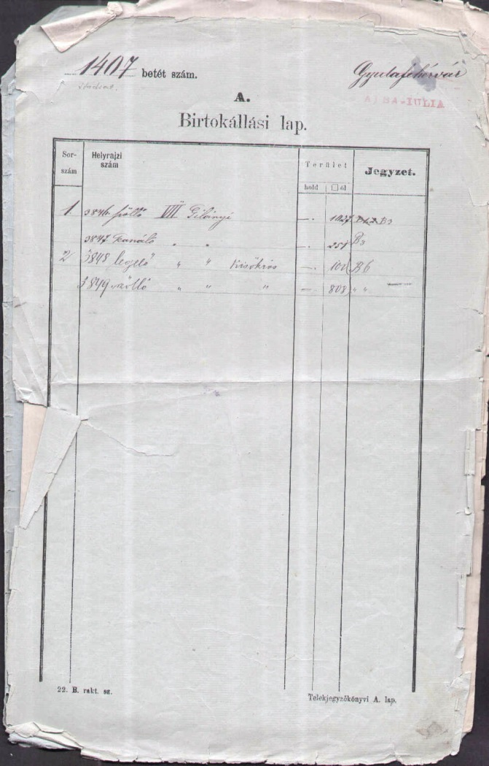
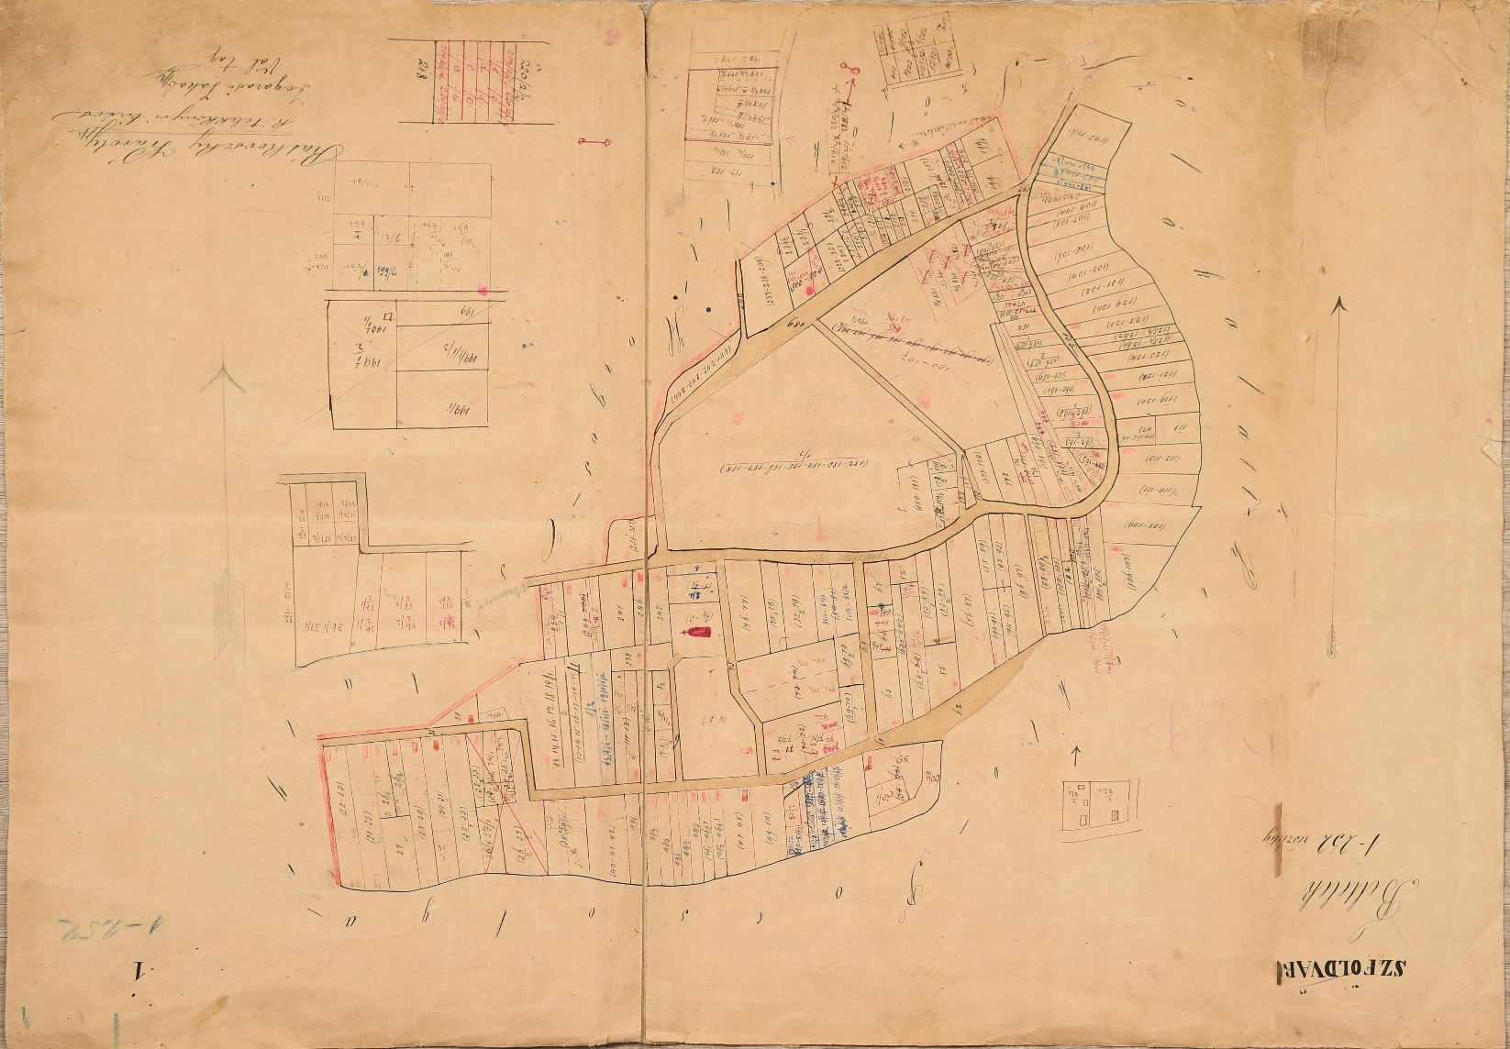
……some old documents
ELRN
Bucharest
Romania
19th of June 2012

Slide 9
Inherited Land registration systems
Registration system based on Transcription-Inscription Registers
Areas where applied
System features
System based on deeds
South and East of Romania
Registration of transaction deeds, mortgages, enforcement measures
Information recorded by years
Registration effect
Identification of the owner: difficult
Identifier of property: none (address in the deed)
For information
ELRN
Bucharest
Romania
19th of June 2012

Slide 10
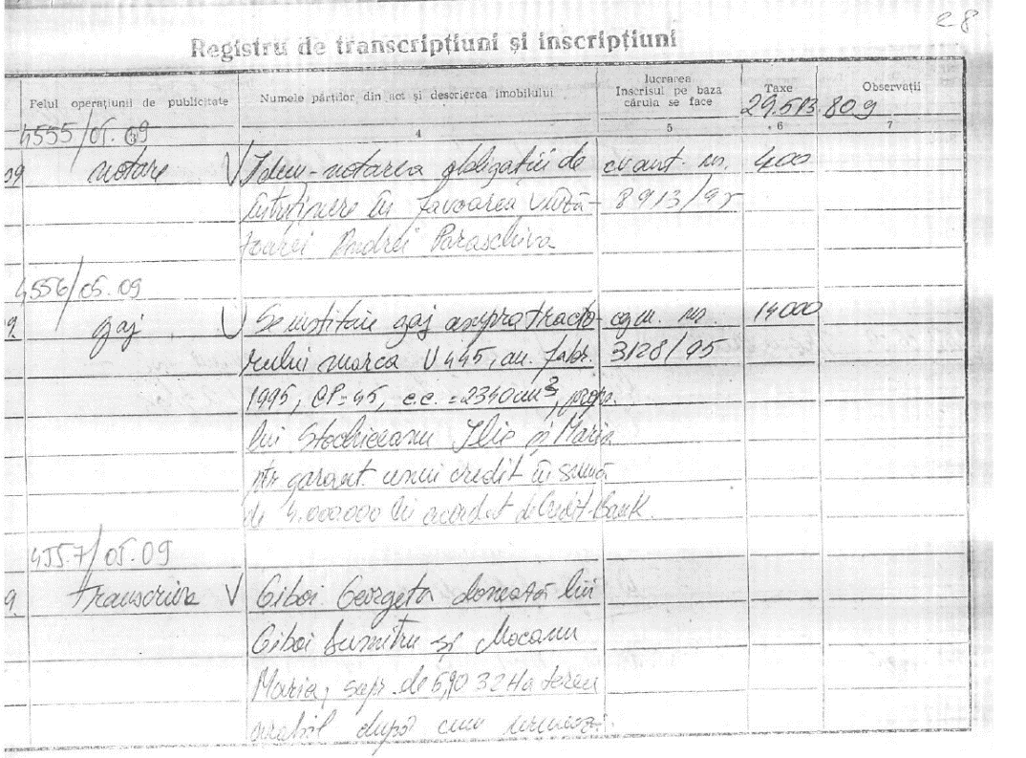
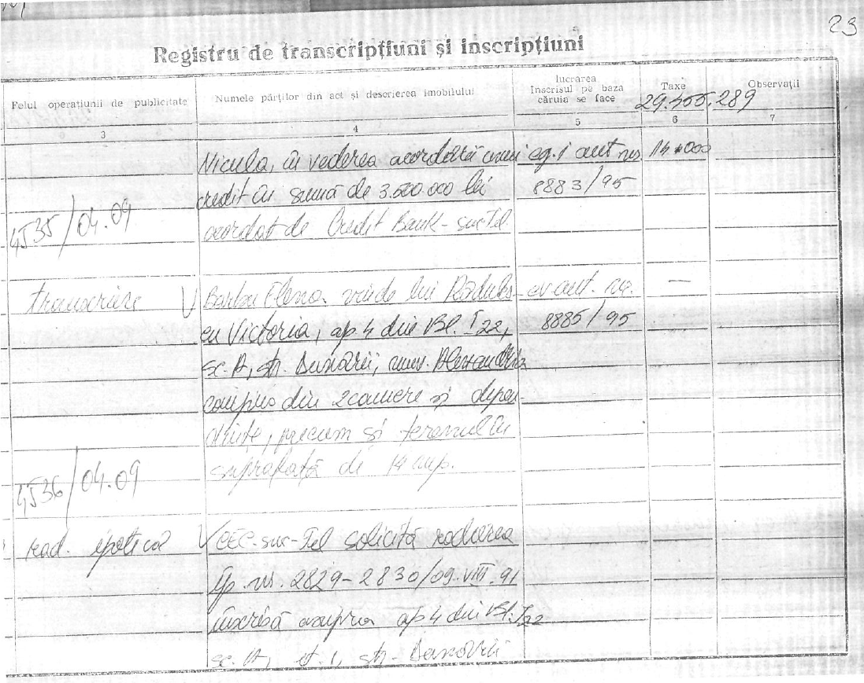
example of deeds registration….
ELRN
Bucharest
Romania
19th of June 2012

Slide 11
Land registration systems nowadays
Registration system based on Cadaster and Land Book
Areas where applied
System features
Legal effect of registration
Trust in the system
Whole country
One unitary and complete registration system
One immovable, one Land Book – system based on property
opposability
“You have Cadastre – you have Ownership”
Identifier of property: cadastral number
Plan of property in stereographic coordinates system
constitutive of rights after completion of systematic cadaster in UAT – new Civil Code 2011
ELRN
Bucharest
Romania
19th of June 2012

Slide 12
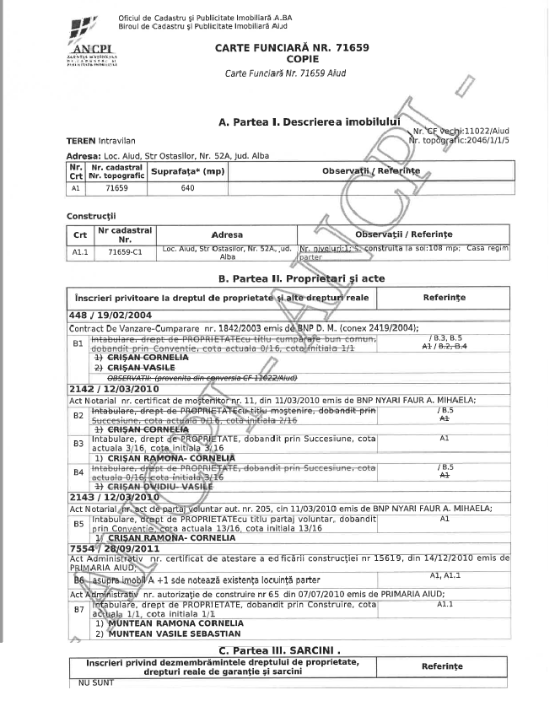
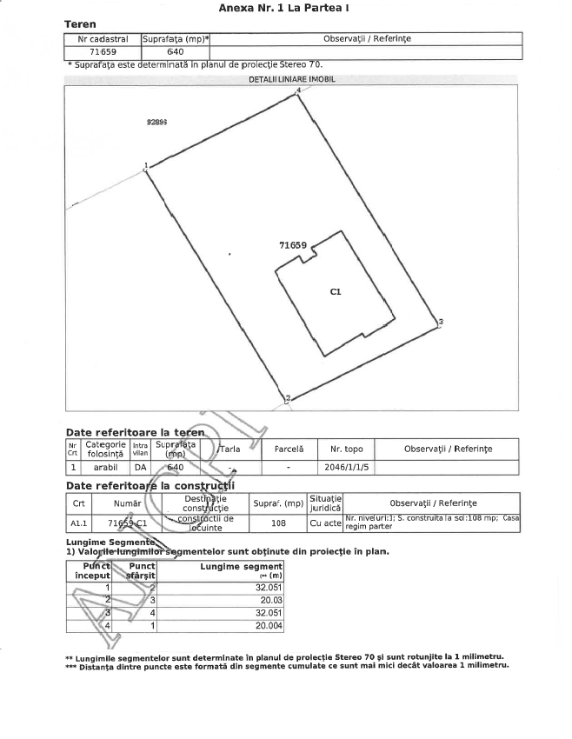
example of new Land Book…
ELRN
Bucharest
Romania
19th of June 2012

Slide 13
Registration process in Romania
Sporadic registration / Systematic cadastre
Assumptions
40 million properties in Romania
12 millions properties registered today, out of which:
11 millions by sporadic registration
1 million by systematic registration
1 million yearly sporadic entries
Sporadic registration
Systematic registration
We would need almost 30 years to complete registration all over the country based on sporadic registration
Systematic cadastre is the solution for a rapid registration of all properties (estimate completion –
7 years)
ELRN
Bucharest
Romania
19th of June 2012

Slide 14
National Program for Cadastre and Land Book
2015 – 2023
Financing
Strategic options
ANCPI revenues: 900 M Eur
Systematic registration developed by ANCPI at UAT level
UE funds: 312 M Eur
Financing the Systematic registration on cadastral sectors performed by City Halls
Financing the Systematic registration of public and private property land
Co-financing by ATUs to accomplish cadaster
ELRN
Bucharest
Romania
19th of June 2012
http://www.ancpi.ro/pnccf/

Slide 15
Results…we are aiming at...
Coherent cadastral plans for all ATUs
All properties registered in the cadaster and land book system
All actual holders: owners, possessors, heirs registered in the land book
The public, private state land recorded
The public, private land of ATUs clarified
Supporting development of infrastructure projects, APIA subsidies for agriculture, informal settlements
ELRN
Bucharest
Romania
19th of June 2012

Slide 16
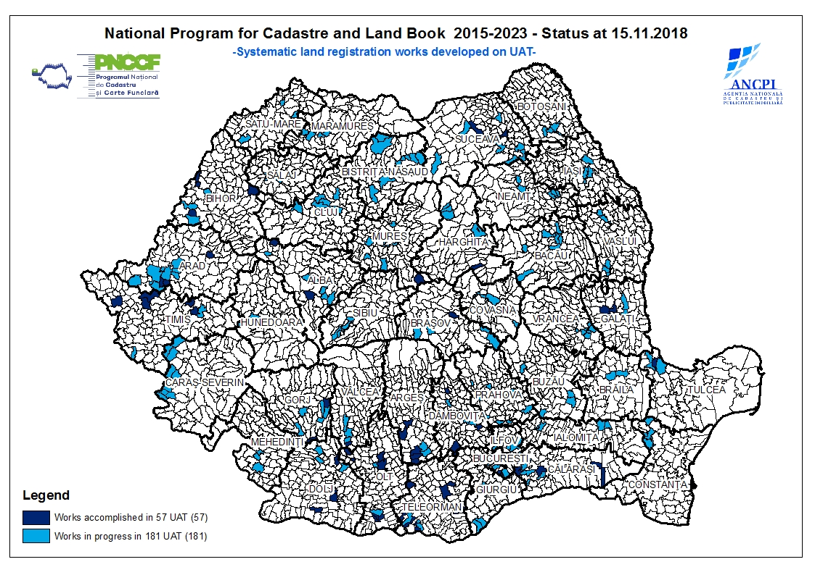
Systematic cadaster – status on ATUs
ELRN
Bucharest
Romania
19th of June 2012

Slide 17
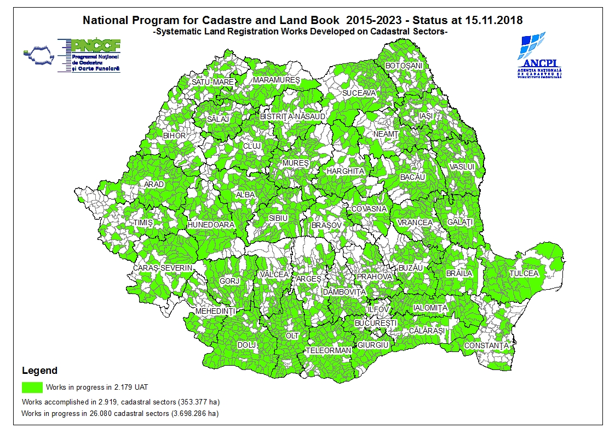
Systematic cadaster – status on cadastral sectors
ELRN
Bucharest
Romania
19th of June 2012

Slide 18
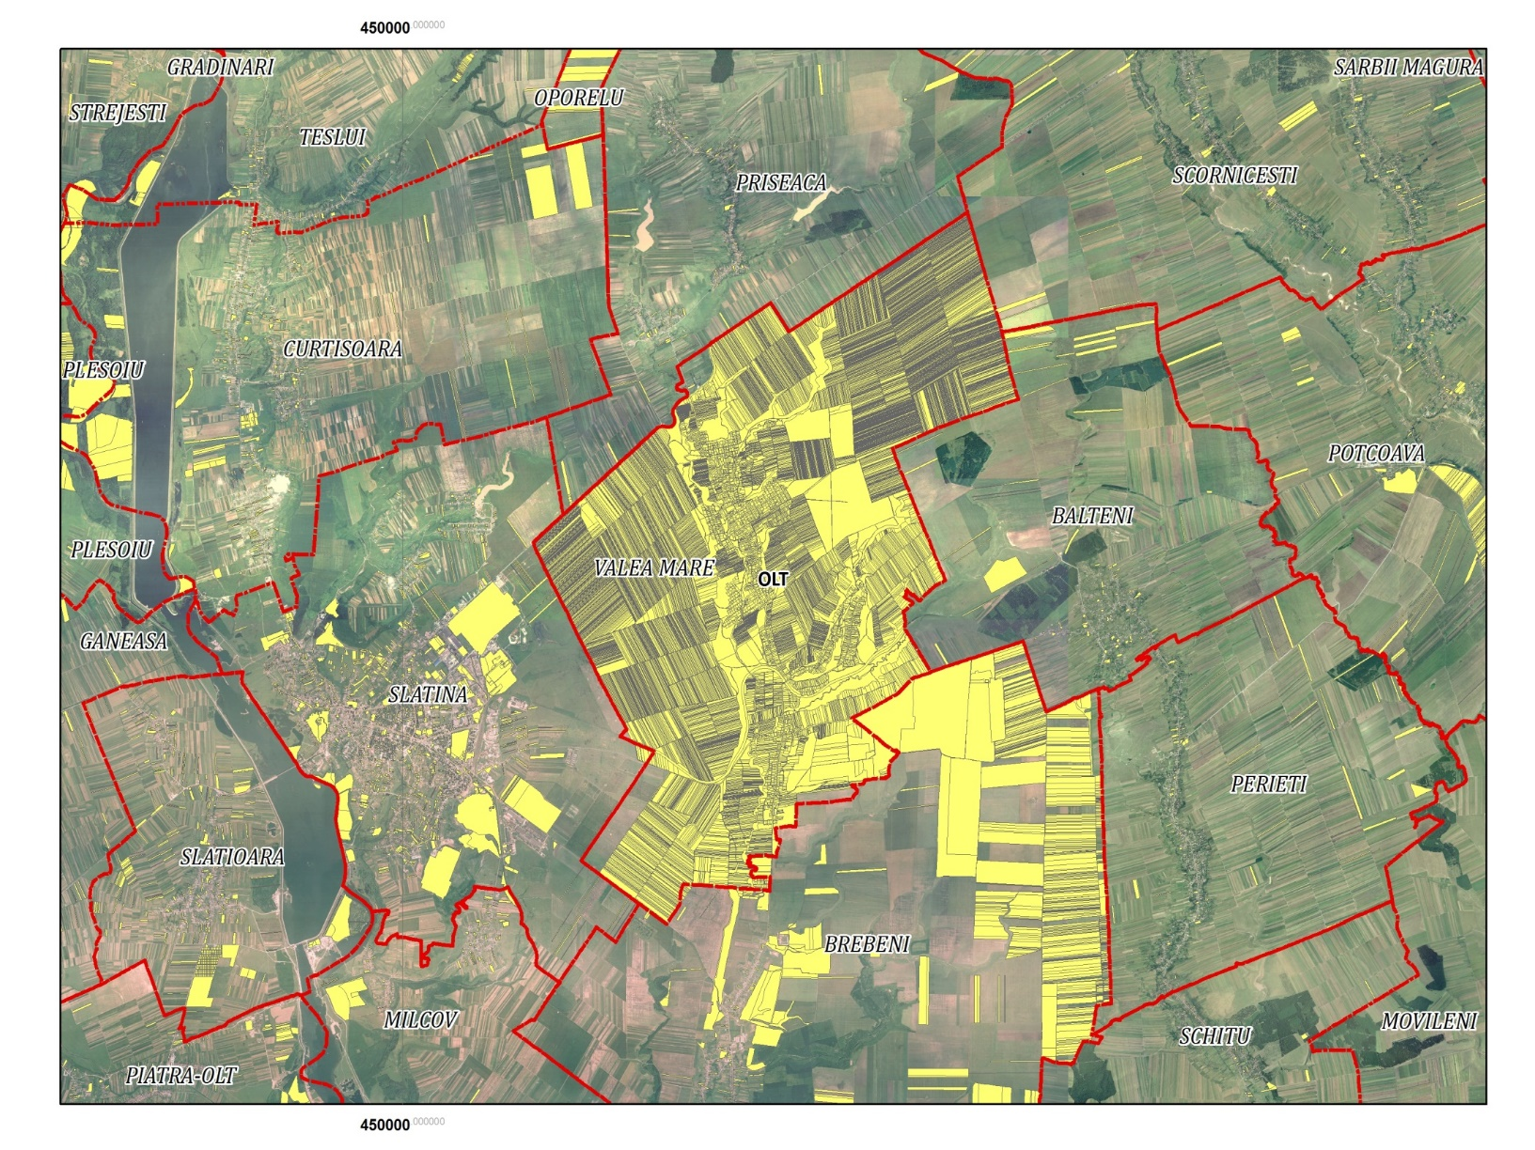
……ATUs with cadaster / ATUs without cadastre
ELRN
Bucharest
Romania
19th of June 2012

Slide 19
Tools which help us to perform
Legislation in place: Law no.7/1996, regulations, guidelines, technical specifications for systematic registration
Qualified staff: ANCPI 600 staff, 750 registered cadaster companies, over 6000 licensed surveyors
Informatic system processing the requests for registration - eTerra
Online services: online applications, electronic payments, online land book extracts
Digital Map of Romania –TOPRO
Romanian Positioning System - ROMPOS
Ortophoto maps covering all Romania
Geoportal: cadastral plans
ELRN
Bucharest
Romania
19th of June 2012

Slide 20
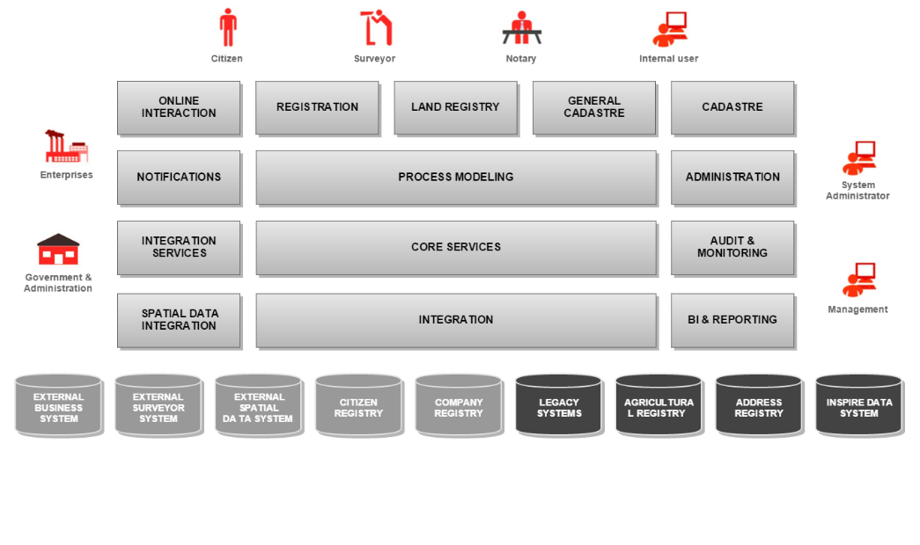
e-Terra system architecture
Functional components
ELRN
Bucharest
Romania
19th of June 2012

Slide 21
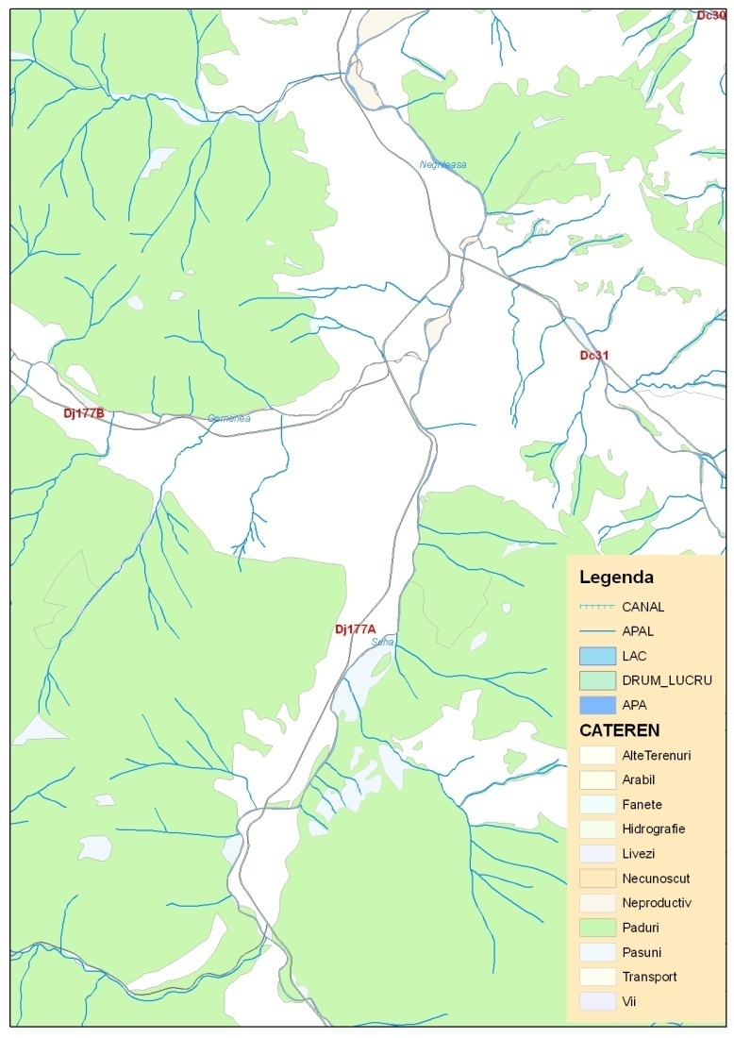
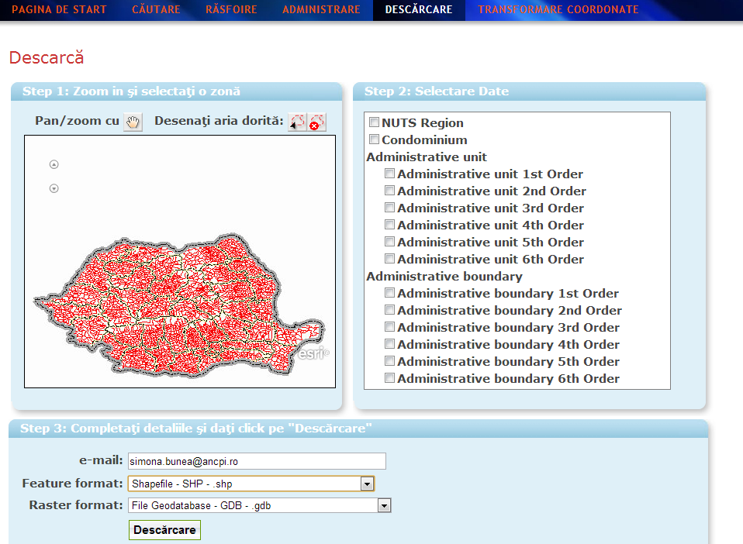
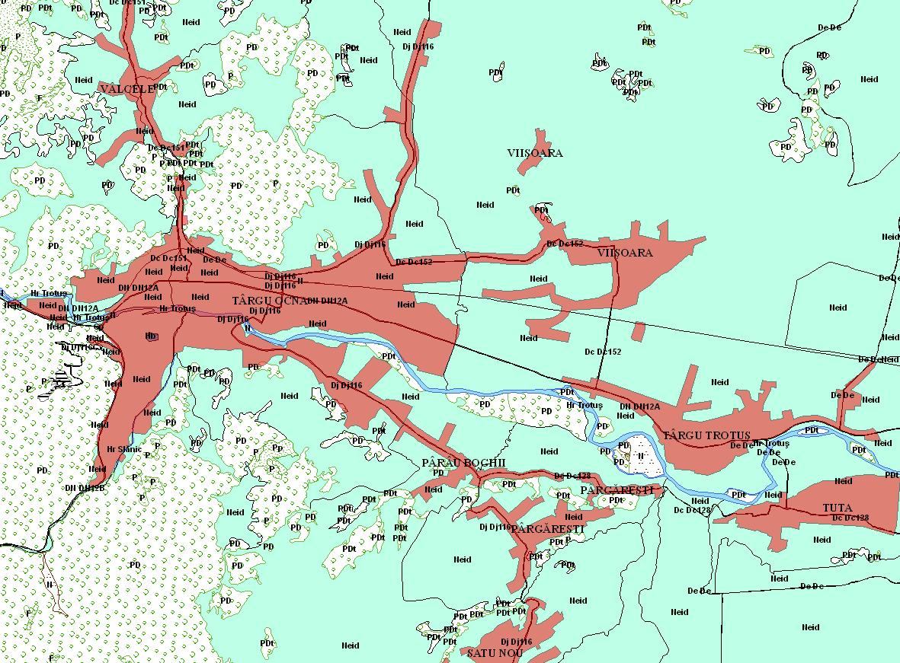
TOPRO5 Digital Map of Romania
… land use … administrative boundaries …
ELRN
Bucharest
Romania
19th of June 2012

Slide 22
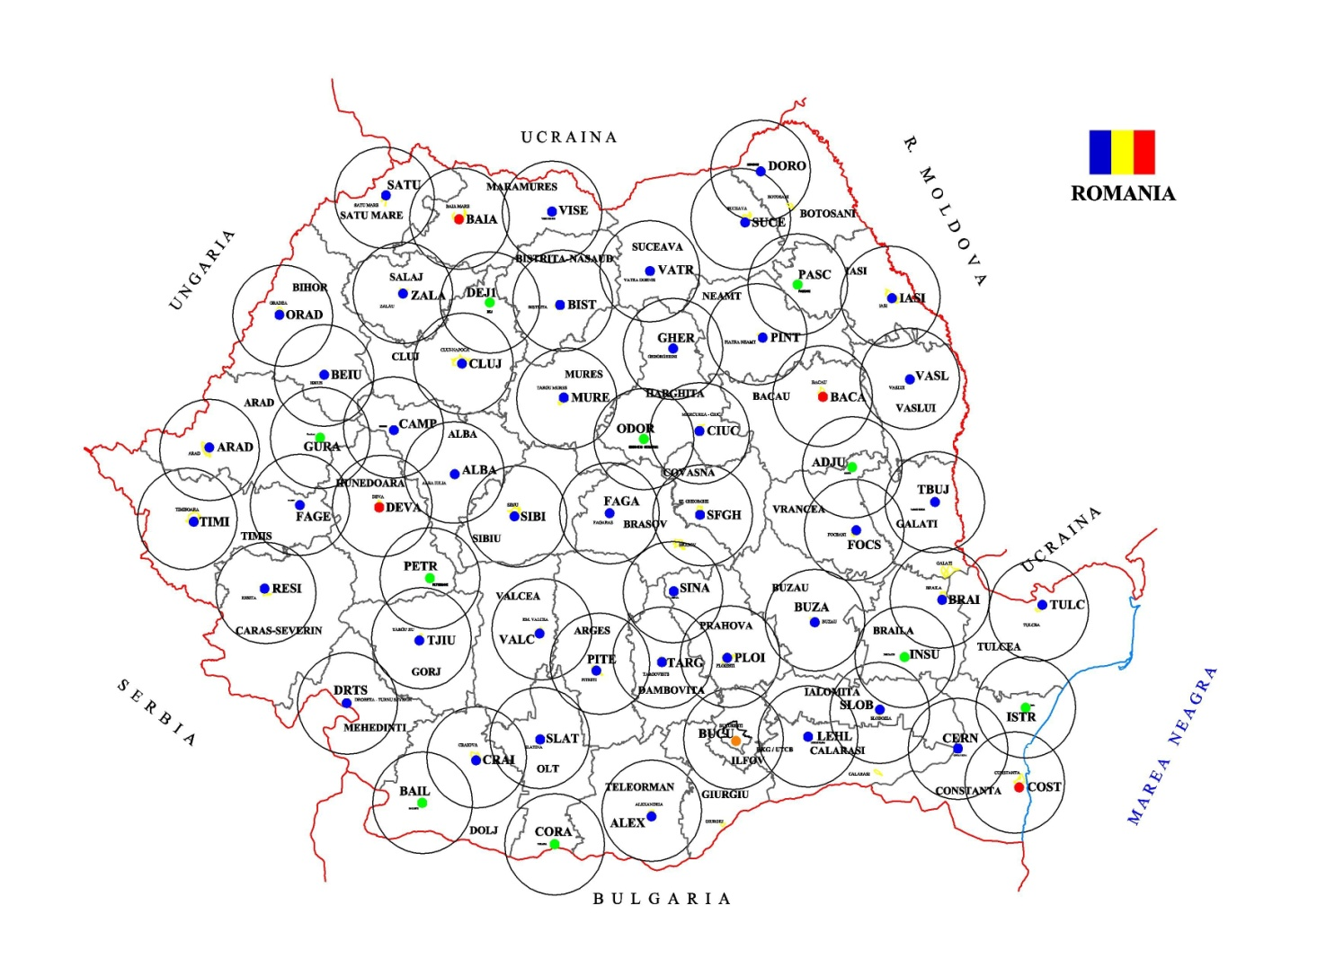
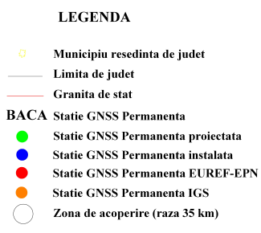
GNSS Permanent stations network
national coverage ... www.rompos.ro
ELRN
Bucharest
Romania
19th of June 2012

Slide 23
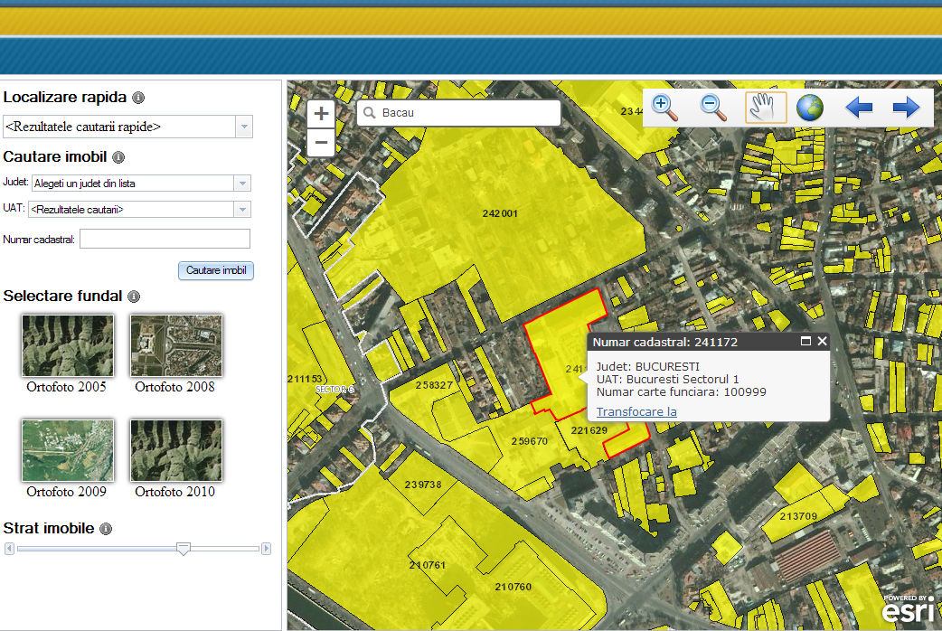
GeoPortal INSPIRE Romania
spatial data and services for e-government
A gateway for all Romanian spatial data
Sharing spatial information and services
A modern infrastructure for land administration and land policies
ELRN
Bucharest
Romania
19th of June 2012

Slide 24
Thank you!
Eugenia SAS
Systematic Registration Directorate
Radu Codruț ȘTEFĂNESCU
General Director
www.ancpi.ro
ELRN
Bucharest
Romania
19th of June 2012

